Slide 1
Chapter Quiz
Coding and Programming

Slide 2
Quiz
Chapter 1
For Student
ⓒ2023 SAMSUNG. All rights reserved.
Samsung Electronics Corporate Citizenship Office holds the copyright of this document.
This document is a literary property protected by copyright law so reprint and reproduction without permission are prohibited.
To use this document other than the curriculum of Samsung innovation Campus, you must receive written consent from copyright holder.

Slide 3
UNIT 1
Sequential Programming
Q. 01-01
The code that prints the sum of the values from 1 to 3 using the print() function is print(1+2+3). With reference to this code, print the sum of the values from 1 to 5 as follows.

Slide 4
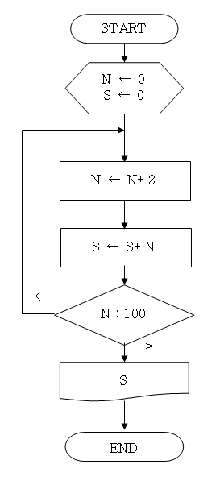
UNIT 2
Planning for Programming
Q. 02-01
The figure below is a flowchart of a program that finds the sum of odd numbers among integers between 1 and 100 and prints the sum. Fill in the blanks in the second figure of the following flowchart.
START
N ← __
S ← __
N ← N + 2
S ← S + N
<
N : 100
≥
S
END

Slide 5
UNIT 2
Planning for Programming
Q. 02-02
We will write a program that receives a positive integer from the user and tells whether it is an odd or even number. Complete the appropriate pseudo code for the underlined part.
print ‘Enter an integer: ’
n = input()
if :
print ‘n is even’
else :
print ‘n is odd’

Slide 6
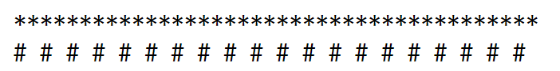
UNIT 3
Basic of Numeric Data Types and Arithmetic Operation
Q. 03-01
Write a code to print the following decorative output. In the first line, use only one '*' character with the operator * and number. In the second line, use only one '#' character and one space with the operator * and number.
Coding guideline: In the case of the first line, print in the same way as '*' * number n. The second line also uses the * operator.

Slide 7
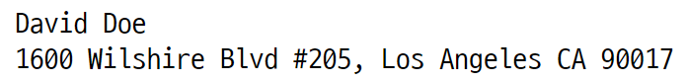
UNIT 4
Variables and Inputs
Q. 04-01
Write and save the following name and address in the name and address variables, respectively. Write a code that prints them to the screen.

Slide 8
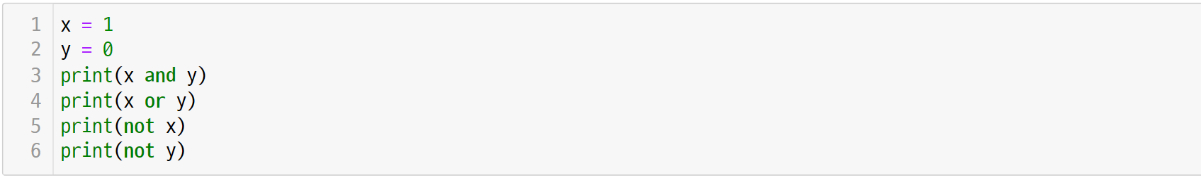
UNIT 5
Logic and Comparison Operators
Q. 05-01
Expect the output of the following code and write it down.

Slide 9
UNIT 6
Conditional Statement-1
Q. 06-01
Write a program that takes two random integers as input and lists them from smallest to largest.
(Condition: Two integers are not the same number.)
Coding guideline: Receive the user's input with the input function and convert it to an integer using the int function. Next, use an if statement to compare and print the two values.

Slide 10
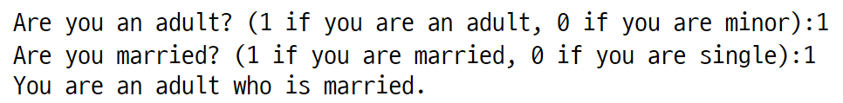
UNIT 7
Conditional Statement-2
Q. 07-01
Write a program that performs the following using a compound conditional expression of an if statement.
Coding guideline: Write a code that performs differently depending on whether the answer to the first question is 0 or 1, as shown below.

Slide 11
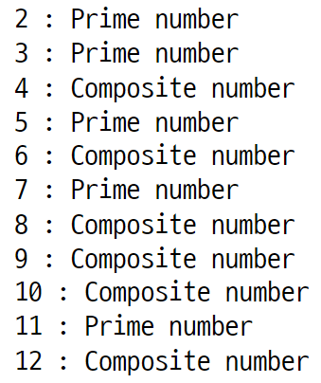
UNIT 8
Loop-1
Q. 08-01
Among the positive natural numbers other than 1, a number that is not prime is called a composite number. Print the prime and composite numbers from 2 to 12 as follows.
Coding guideline: Use the for statement to solve this problem. When using a nested for statement, an expression for determining a prime number must be entered in the inner for statement.

Slide 12
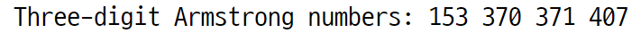
UNIT 9
Loop-2
Q 09-01
An Armstrong number is a three-digit integer that is equal to the sum of the cubes of each digit. Find all Armstrong numbers among three-digit integers and print them as follows.
Coding guideline: All numbers from 100 to 999 should be searched using the for statement.

